Slide 1


Zillow Prize
Zillow’s Home Value Prediction
Avaliando impacto da adição de hidden layers
em uma Rede Neural.
by Tales Tenorio Pimentel

Slide 2

Zillow Prize
Predictive modeling and Analytics challenge
Hosted by
Link here

Slide 3

Zillow Prize
Notes:
Corretora de Seguros

Slide 4

Zillow Prize
Notes:
Visitar propriedades
Avaliar
Preço

Slide 5
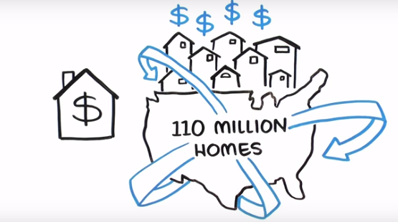
Zillow Prize
Notes:
Visitar residencias em TODO o país?

Slide 6

Zillow Prize
Zestimate
Notes:
Não!
Zestimate neles!

Slide 7


Zillow Prize
Notes:
OK
Zestimate FALHO
Pode MELHORAR

Slide 8

Zillow Prize
Can you improve the algorithm that changed the world of real estate?

Slide 9
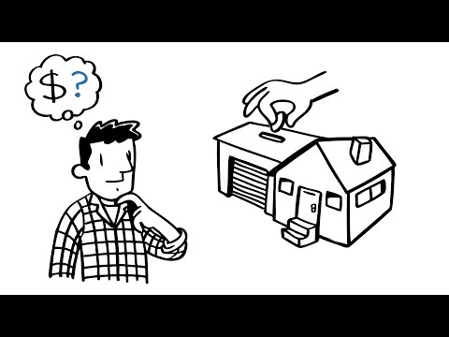
Zestimate

Slide 10
Zillow Prize
Data
Predictions
Zestimate
Algorithm

Slide 11
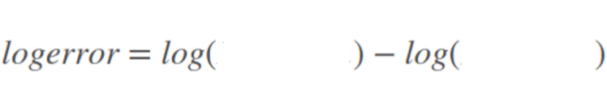
Zillow Prize
target variable: logerror
predictions
sale price

Slide 12
Zillow Prize
Data
logerror
My
Modeling
Notes:
Problema

Slide 13
The Data
~ 48 attributes + target
~ numeric attributes used
~63k rows

Slide 14
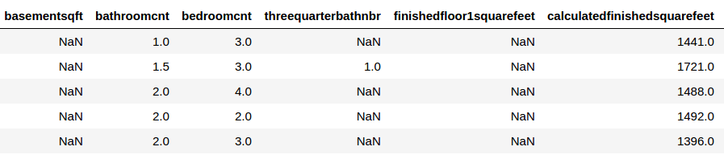
The Data
Missing values

Slide 15
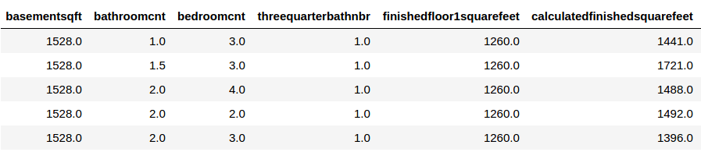
The Data
Missing values replaced by column median

Slide 16
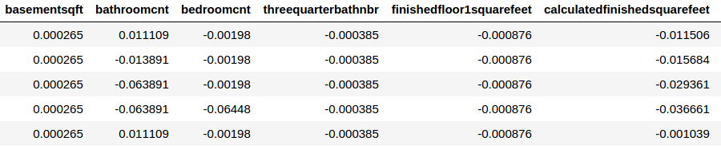
The Data
Normalizing data (-1, +1)

Slide 17
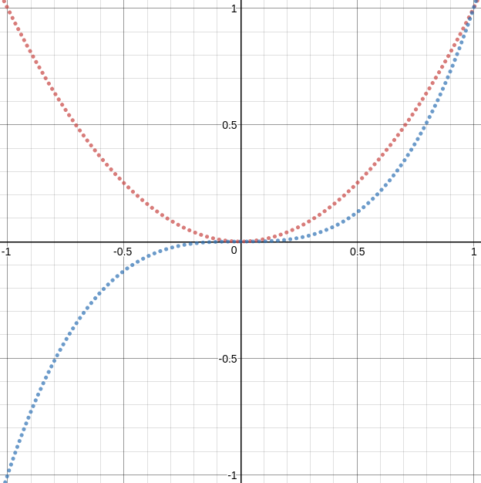
The Data
Normalizing data (-1, +1)
Notes:
Normalizar -1 +1 para explorar melhor os termos de TERCEIRO GRAU

Slide 18
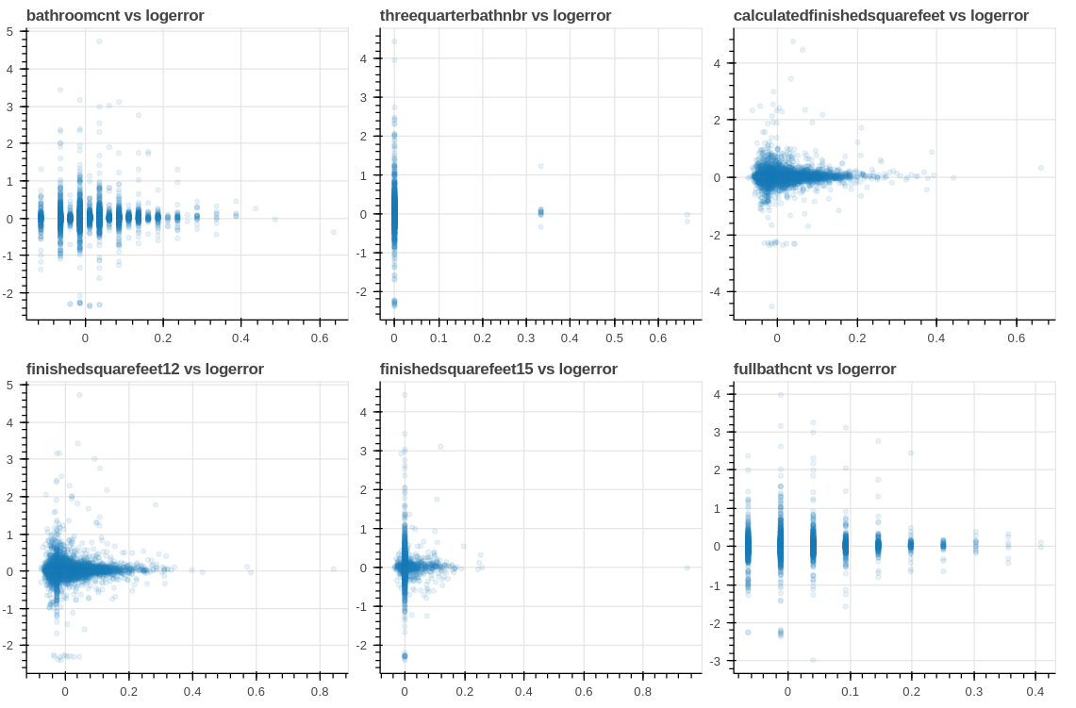
The Data
Feature Selection
SelectKBest

Slide 19
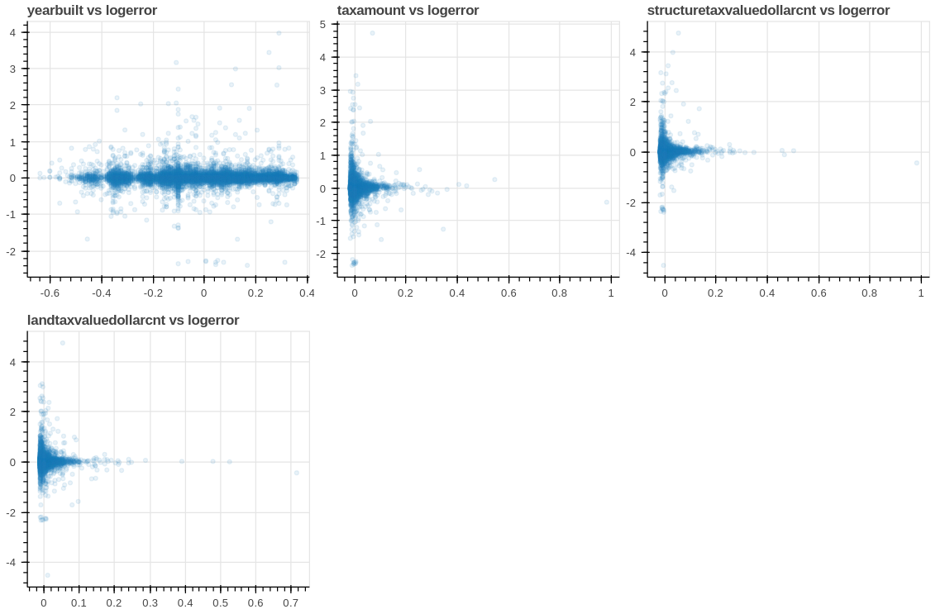
The Data
Feature Selection
SelectKBest

Slide 20
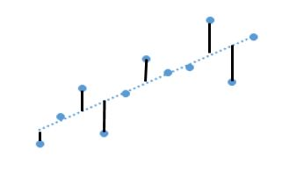
Modeling
Score Metric
Validation
~ Mean Absolute Error
~ Cross Validation
~ k = 5

Slide 21
Modeling
SGDRegressor
(Stochastic Gradient Descent)
learning rate: 0.001
max_iter: 1000
MLPRegressor
(Multi Layer Perceptron)
neurons per layer: 1.5 * number of attributes
hidden layers size: [10, 50, 100, 200, 300, 400]

Slide 22
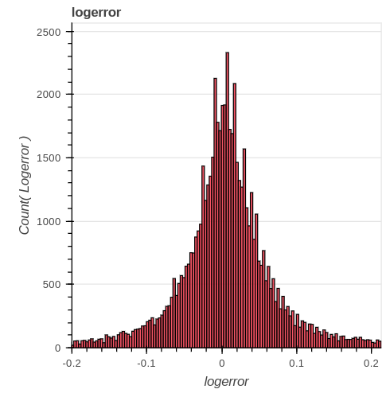
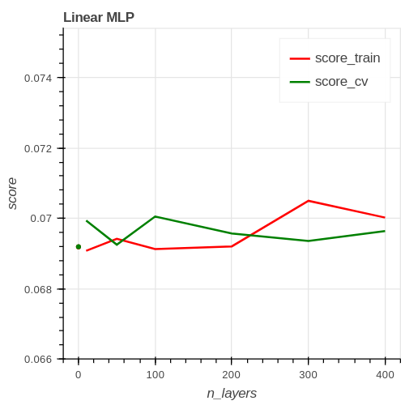
Modeling

Slide 23
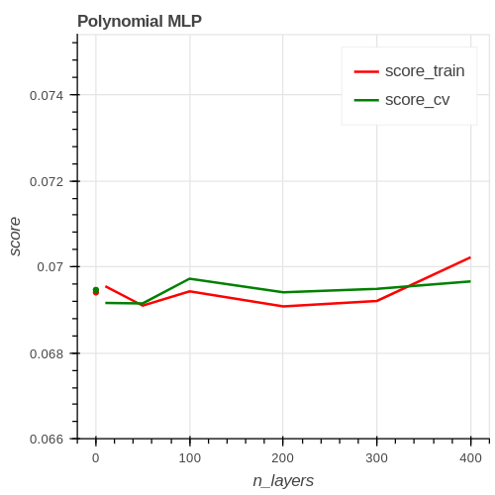
Modeling
Notes:
Lembrar da NORMALIZAÇÃO -1 +1
Polynomial
GRAU 3
Select 10 Best Features

Slide 24
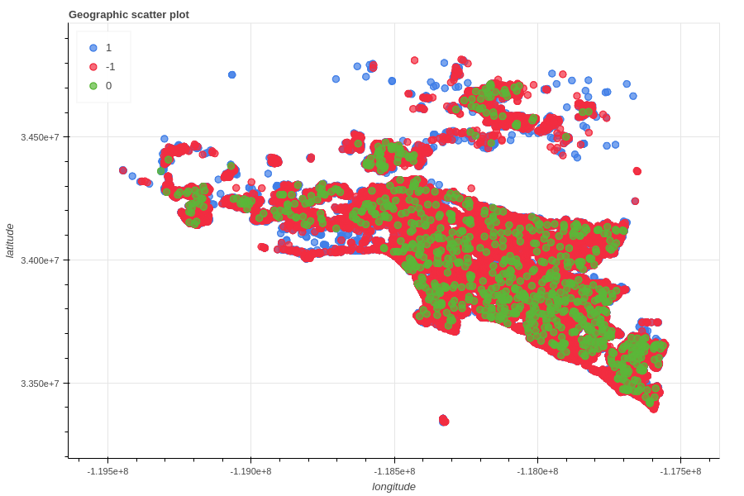
Modeling
Feature Engineering

Slide 25
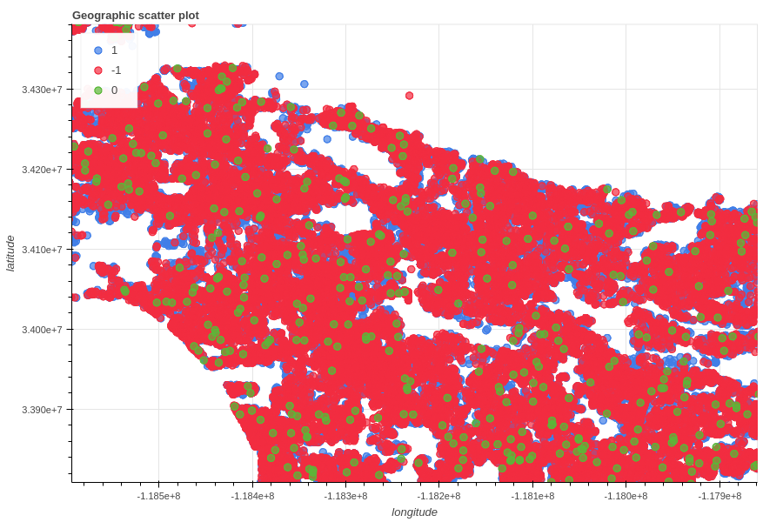
Modeling
Feature Engineering

Slide 26
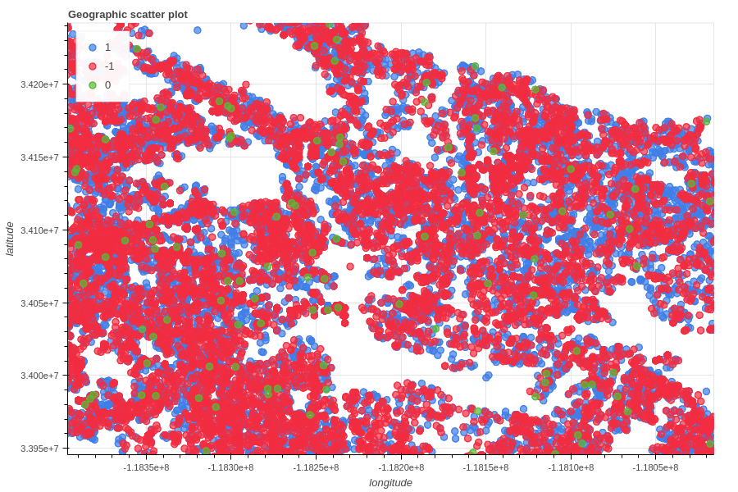
Modeling
Feature Engineering

Slide 27
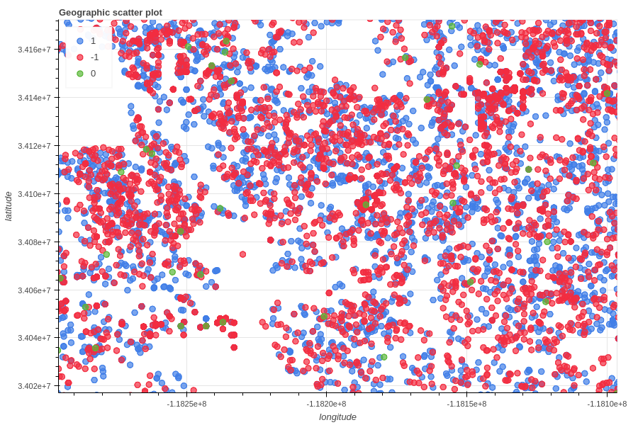
Modeling
Feature Engineering

Slide 28
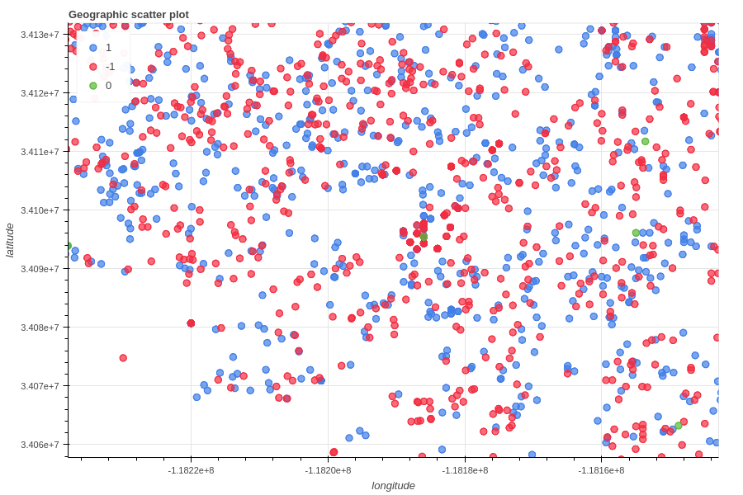
Modeling
Feature Engineering

Slide 29
Modeling
Feature Engineering
nn_logerror_median
Neighborhood logerror median
Neighborhood.size = 2

Slide 30
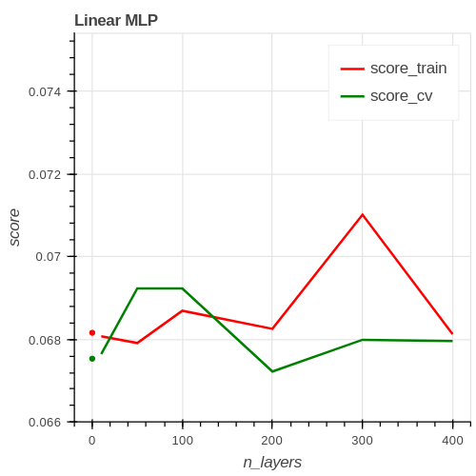
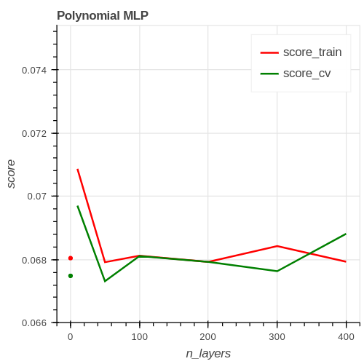
Modeling
Default attributes
With nn_logerror_median
Notes:
Lembrar da NORMALIZAÇÃO -1 +1
Polynomial
GRAU 3

